Slide 1
Team 7’s Presentation
Members: Harrison Chachko, Ang Peng, Jessica Noel, Owen Dawson, Phong Mai

Slide 2
Description:
The Canvas Central website is an art blog created with the purpose of having a platform to share, view, and download the art prints of users. Users can submit their work to an email address, which can be found on the FAQ page. If the uploaded material are deemed appropriate by our team, it will be displayed on the home page and under a specific theme. When users click on a specific image, they will be taken to a page that describes the piece and indicates the artist. The page will also allow for more detailed viewing of the image itself.

Slide 3
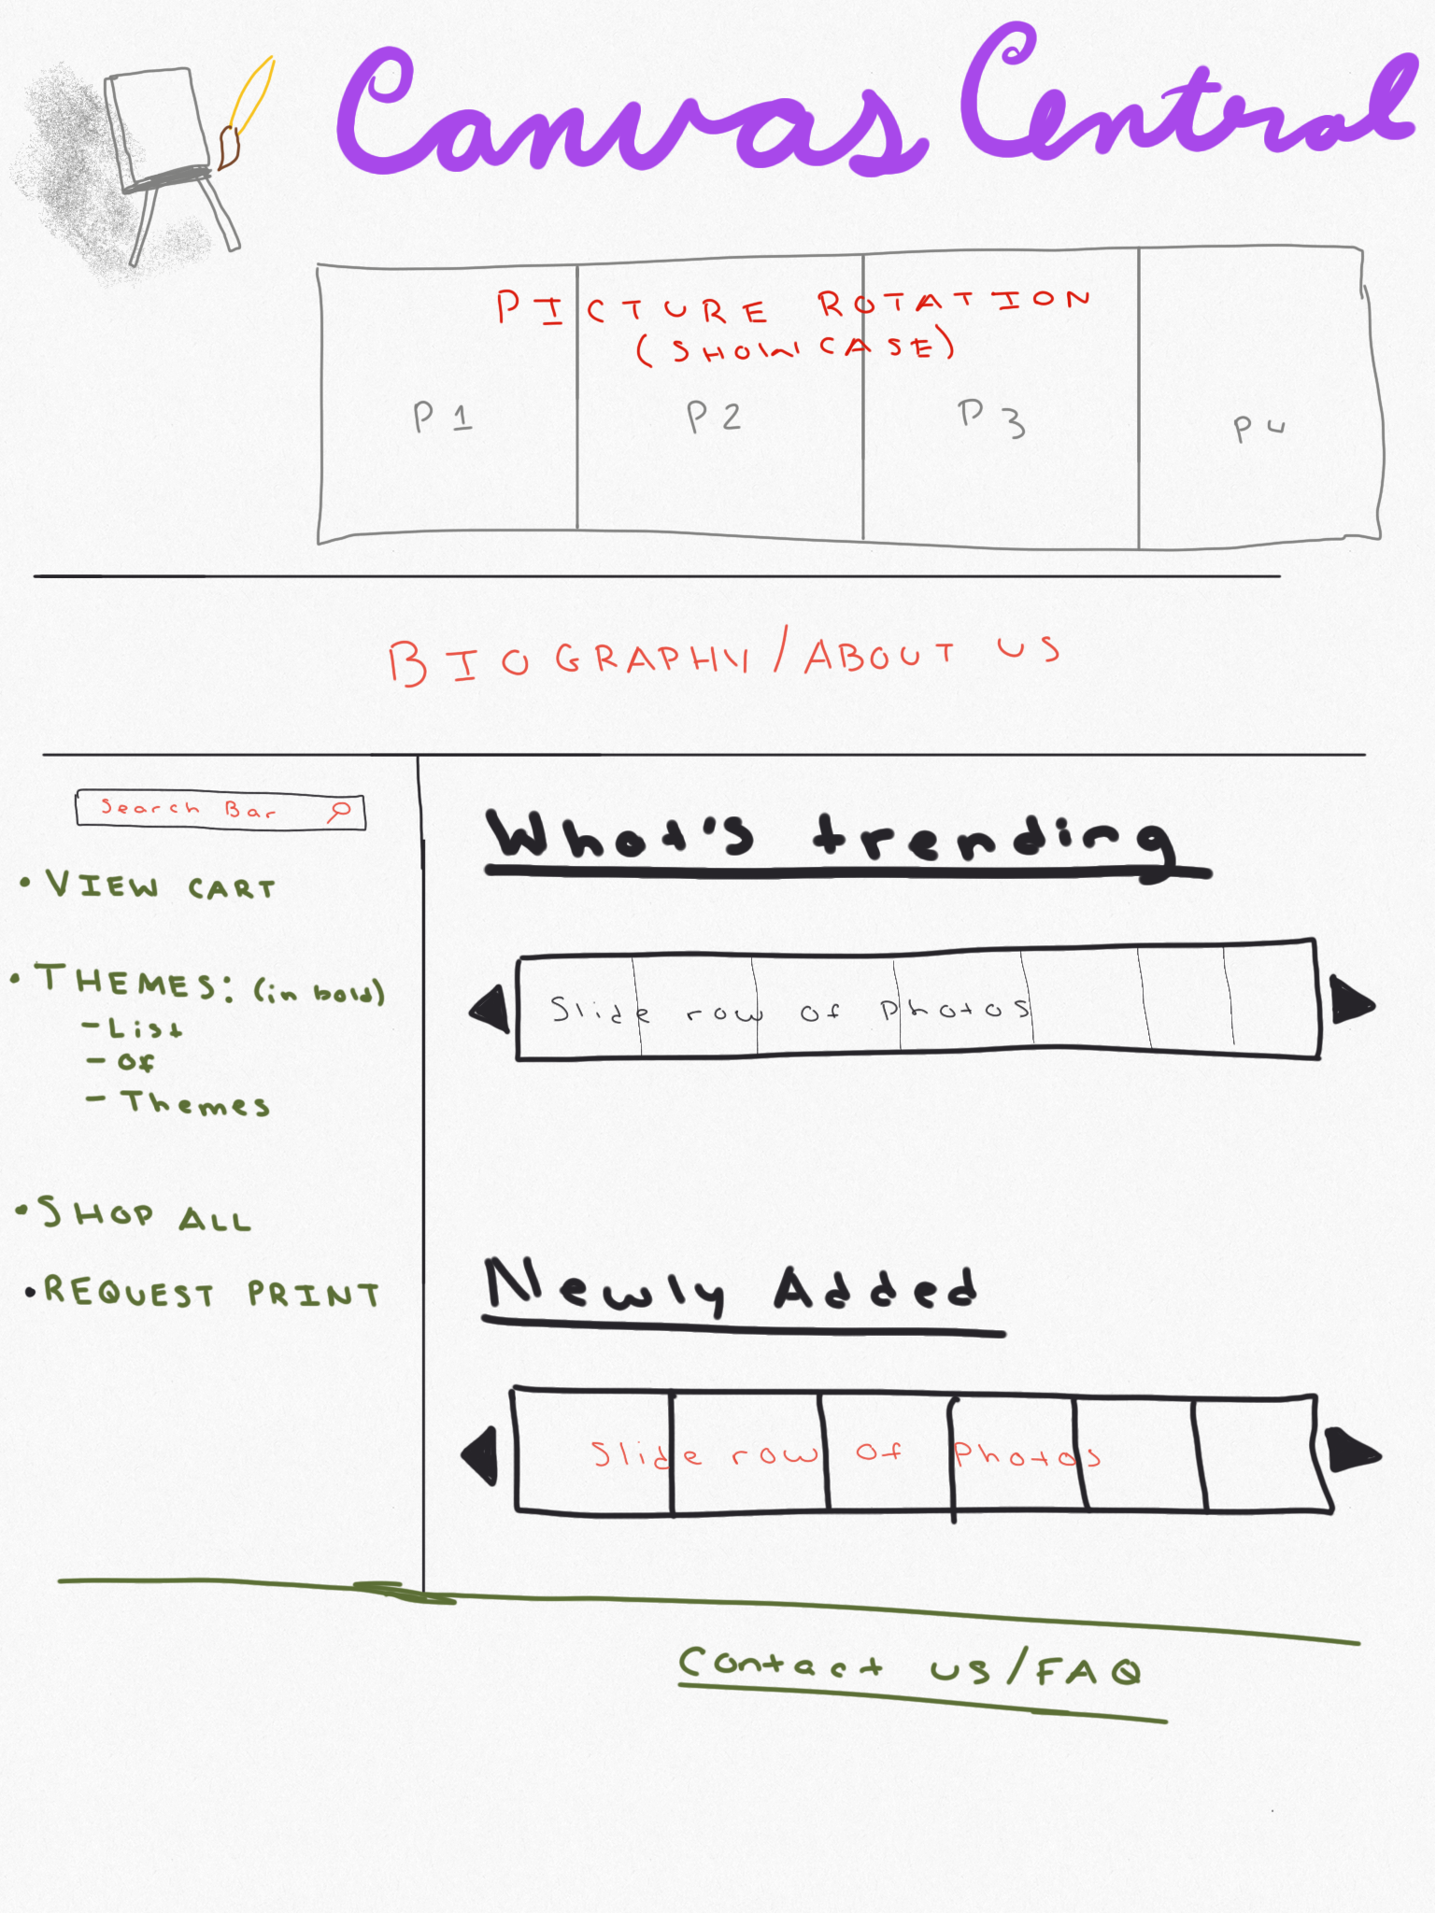
Original Sketch:

Slide 4

Demonstration Video:

Slide 5
Use of HTML
Created a NavBar in order to navigate certain web pages easily
Used the <div> element throughout the site to create different sections on each page
Used <h1> and <h2> for various section titles
Used <p> for general text

Slide 6
DOM Diagram:
FAQ.html
<html>
<head>
<body>
<link>
<link>
<div>
<div>
<div>
“href”
“href”
“class”
“class”
“class”
Name: “head”
Name: “icon-bar”
Name: “questions”
<h2>
<a>
<ul>
<p> Text
“href”
<li>

Slide 7
Use of CSS
We used CSS to create a universal theme throughout the site, including the website header and the navbar at the top
We used media queries to adjust for different screen sizes with responsive css
We used class selectors to adjust individual <div> classes
Use of Javascript
We used google JQuery API
We used JQuery for picture zoom in when mouse cursor hovers on the picture.

Slide 8
Member Contributions:
Harrison:
Developed the html for the main page and FAQ
Developed the responsive css for multiple pages
Owen:
Created the css used on the FAQ and Theme pages
Merged css of different pages into one index.css for the main pages of the website
Jessica:
Developed the html and css for each individual art print page
Drew every art piece used on the website
Developed the html for each tab page
Ang:
Designed the logos for the website and wrote art piece descriptions
Created the css for the home page
Phong:
Created JavaScript picture zoom function

Slide 9
GitHub Repository Link:
https://github.com/chachky/146Project

